Slide 1
ZAS Academy
Python Curriculum for IOT & AI

Slide 2
Day5 - Agenda
Day 6
Blynking LED
Touch sensor
DHT11 sensor
Touch sensor Email / Ultrasonic sensor

Slide 3
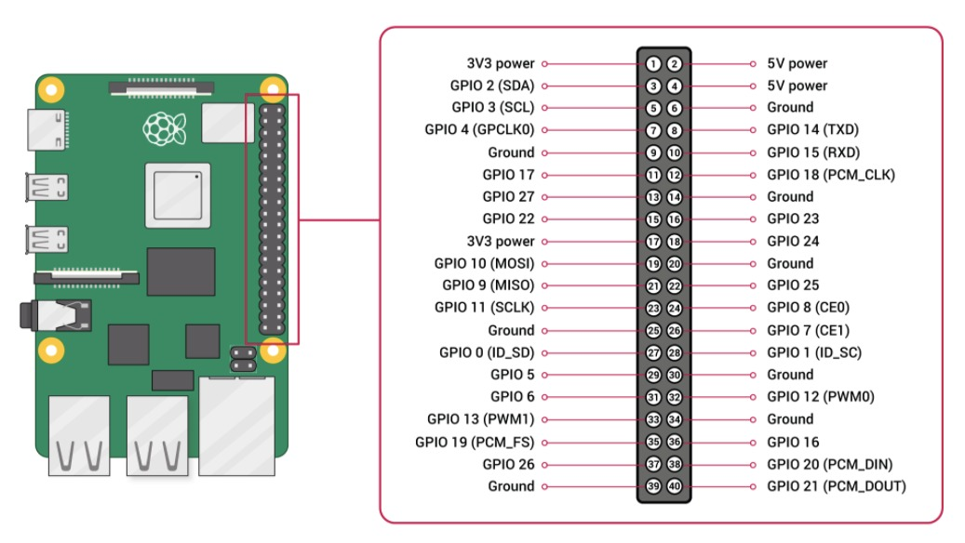
Pi Pin Diagram

Slide 4
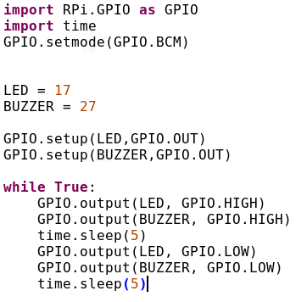
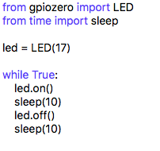
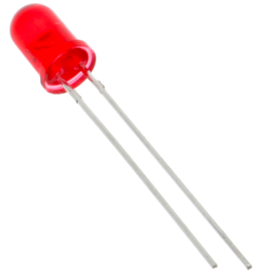
PILED

Slide 5
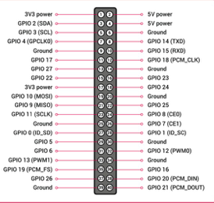
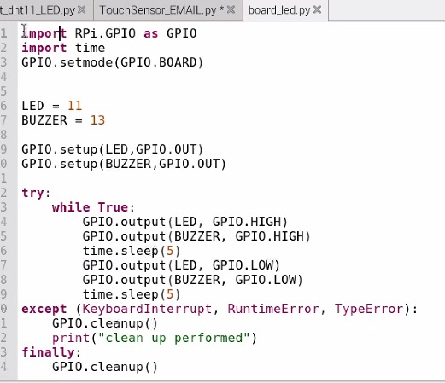
PILED
B
O
A
R
D
B
C
M

Slide 6
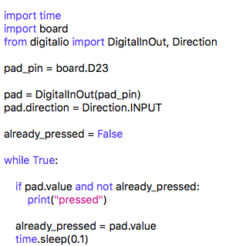
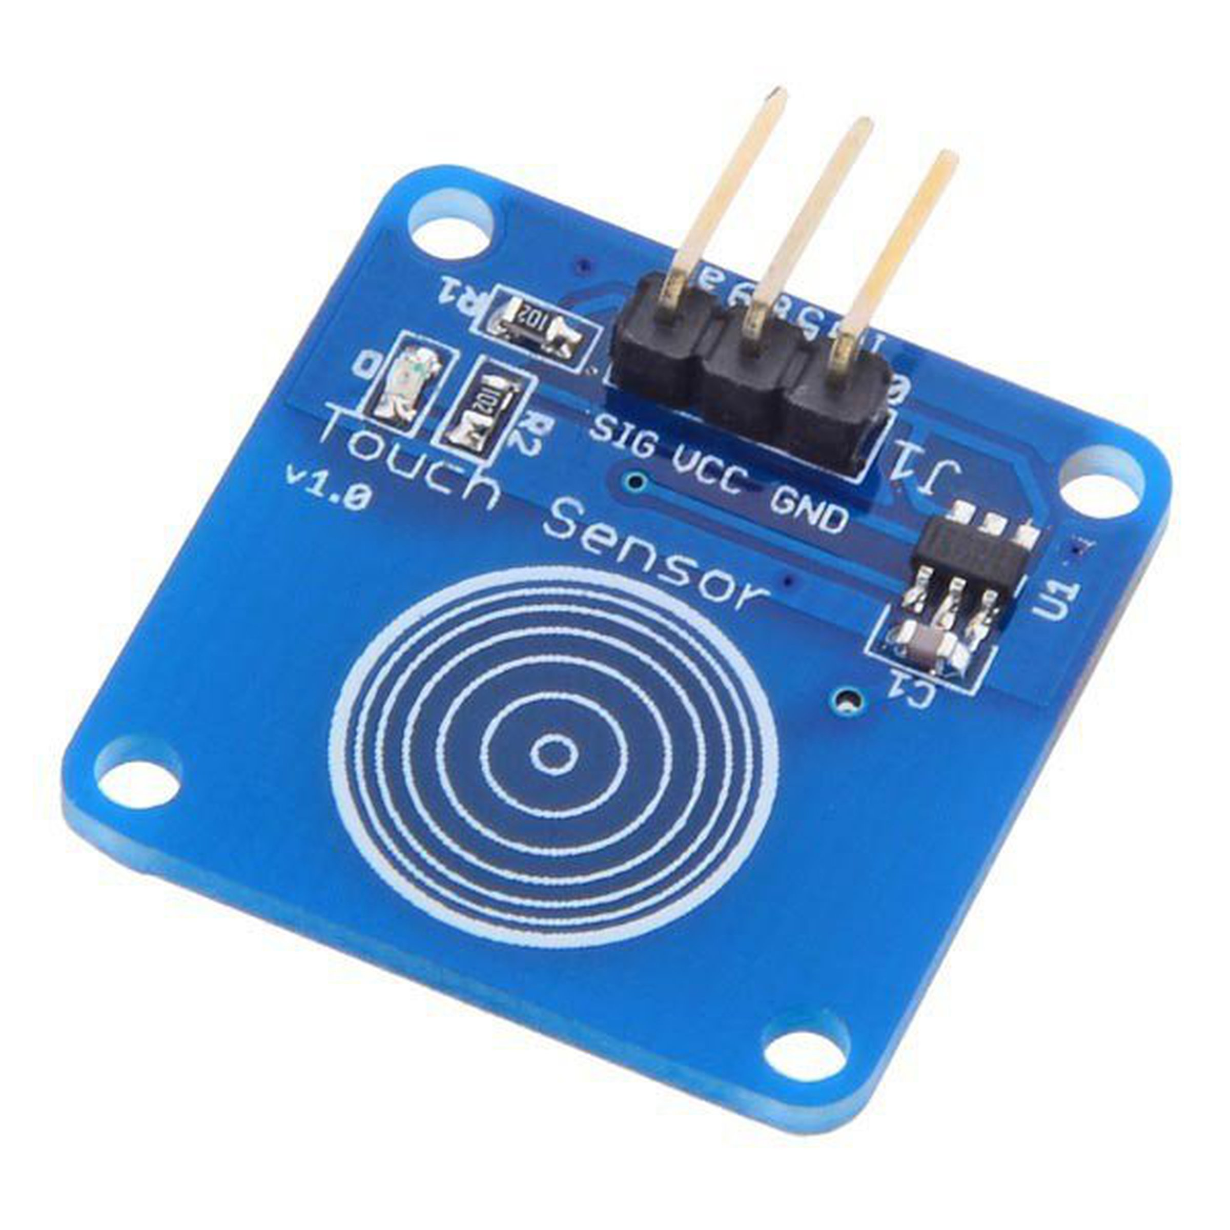
Touch Sensor

Slide 7
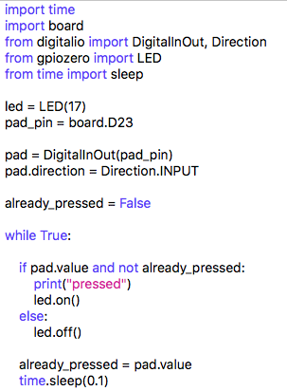
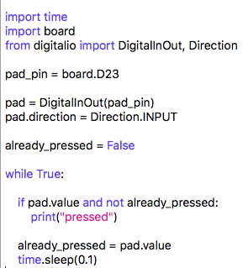
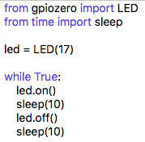
Touch Sensor

Slide 8
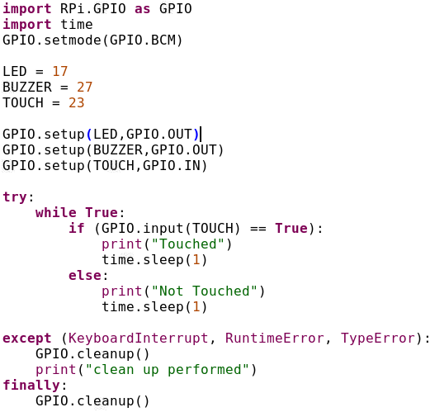
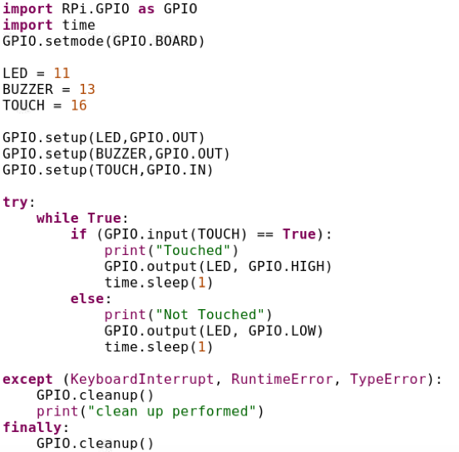
Touch Sensor BCM & Board
Library
BCM
BOARD

Slide 9
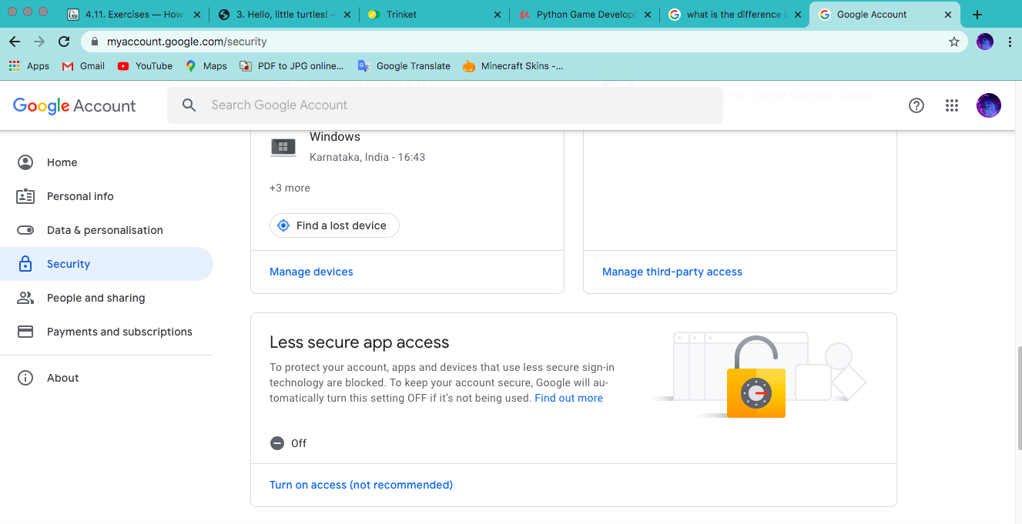
Gmail Settings

Slide 10
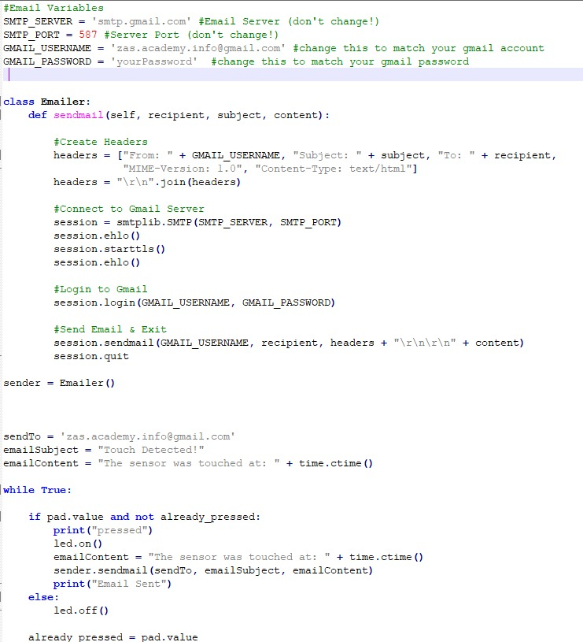
Email Settings

Slide 11
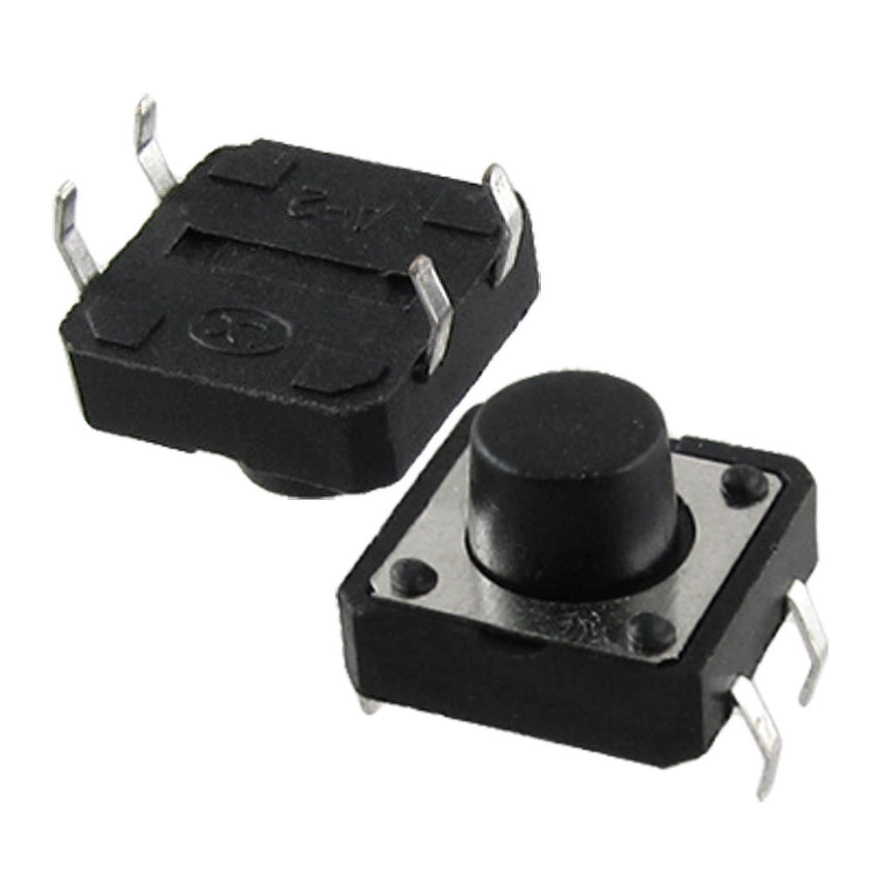
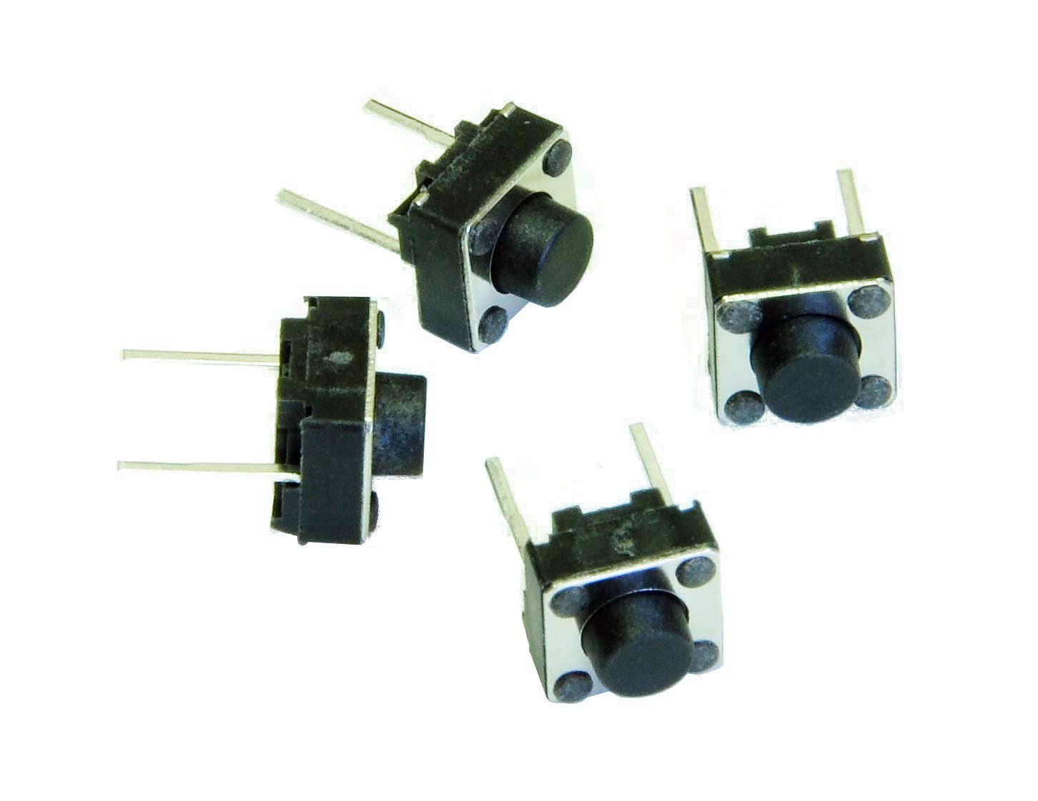
Switch

Slide 12
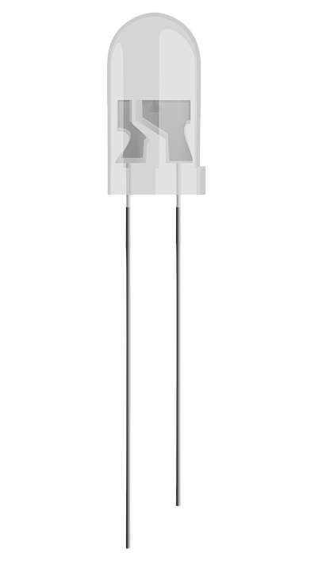
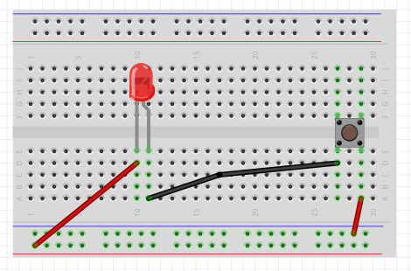
LED, Battery and Switch
Long leg - positive
Short leg - Negative
Negative
Positve

Slide 13
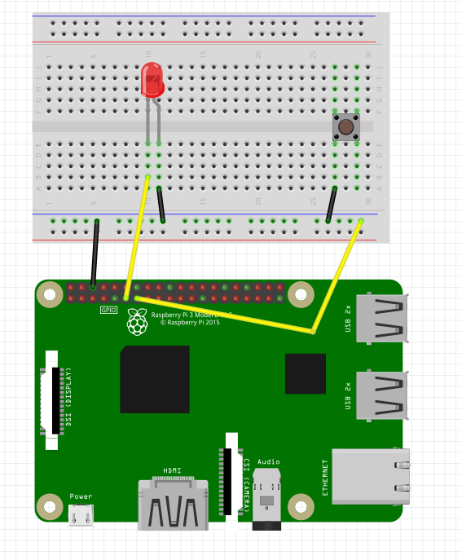
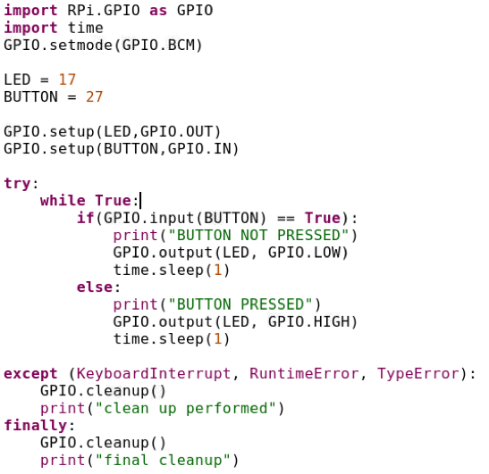
Button
Input GPIO Pins are Pulled High by default

Slide 14
Logistics
Lecture | Date | Day | Time | Comments
1 | 15-Aug-2010 | SAT | 09:00AM
2 | 22-AUG-2020 | SAT | 09:00AM
3 | 29-AUG-2020 | SAT | 09:00AM
4 | 05-Sep-2020 | SAT | 09:00AM
5 | 12-Sep-2020 | SAT | 09:00AM
 | 19-Sep-2020 | SAT | 09:00AM | Midterm Exams
6 | 26-Sep-2020 | SAT | 09:00AM
7 | 03-OCT-2020 | SAT | 09:00AM
8 | 10-OCT-2020 | SAT | 09:00AM
9 | 17-OCT-2020 | SAT | 09:00AM
 | 24-OCT-2020 | SAT | 09:00AM | Dasara Break
 | 31-OCT-2020 | SAT | 09:00AM | Dasara Break
10 | 07-NOV-2020 | SAT | 09:00AM
 | 14-NOV-2020 | SAT | 09:00AM | Diwali Break
11 | 21-NOV-2020 | SAT | 09:00AM
12 | 28-NOV-2020 | SAT | 09:00AM

Slide 15
